Slide 1


BIG DATA ANALYTICS (CS-431)
Dr. Sriparna Saha
Associate Professor
Website: https://www.iitp.ac.in/~sriparna/
Google Scholar: https://scholar.google.co.in/citations?user=Fj7jA_AAAAAJ&hl=en
Research Lab: SS_Lab
Core Research AREA: NLP, GenAI, LLMs, VLMs, Multimodality, Meta-Learning, Health Care, FinTech, Conversational Agents
TAs: Sarmistha Das, Nitish Kumar, Divyanshu Singh, Aditya Bhagat, Harsh Raj

Slide 2
Challenges in Big Data Systems
Big Data systems like Hadoop and Spark run on large clusters of machines.
Coordinating tasks and managing shared state across hundreds of nodes is complex.
Node failures are common and must be handled automatically to prevent system downtime.
This creates a need for a robust, distributed coordination service.

Slide 3

Apache ZooKeeper's Role in Big Data
It basically keeps track of information that must be synchronized across your cluster
Which node is the master?
What tasks are assigned to which workers?
Which workers are currently available?
It's a tool that applications can use to recover from partial failures in your cluster.
An integral part of HBase, High-Availability (HA) MapReduce, Drill, Storm, Solr, and much more

Slide 4
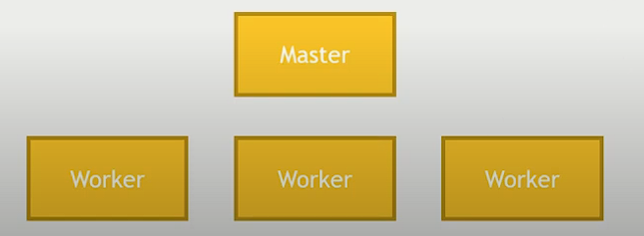
Apache ZooKeeper's Failure Mode
Master crashes, needs to fail over to a backup
Worker crashes - its work needs to be redistributed
Network trouble - part of your cluster can't see the rest of it

Slide 5
Primitive operations in a distributed system
Master election
One node registers itself as a master, and holds a “lock” on that data
Other nodes cannot become master until that lock is released
Only one node allowed to hold the lock at a time
Crash detection
“Ephemeral” data on a node’s availability automatically goes away if the node disconnects, or fails to refresh itself after some time-out period.
Group management
Metadata
List of outstanding tasks, task assignments

Slide 6
Primitive operations in a distributed system
Master election
One node registers itself as a master, and holds a “lock” on that data
Other nodes cannot become master until that lock is released
Only one node allowed to hold the lock at a time
Crash detection
“Ephemeral” data on a node’s availability automatically goes away if the node disconnects, or fails to refresh itself after some time-out period.
Group management
Metadata
List of outstanding tasks, task assignments
But ZooKeeper's API is not about these primitives.
Instead they have built a more general purpose system that makes it easy for applications to implement them.

Slide 7
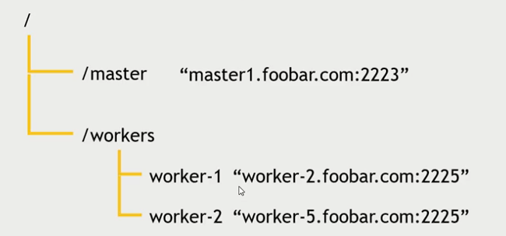
Zookeeper's API
Really a little distributed file system
With strong consistency guarantees
Replace the concept of “file” with “znode” and you’ve pretty much got it
ZooKeeper provides a general API (znodes, watches, ephemeral nodes) that lets applications implement things like master election, crash detection, and group management on top of it.
Here's the ZooKeeper API:
Create, delete, exists, setData, getData, getChildren

Slide 8
Persistent and ephemeral znodes
Persistent znodes remain stored until explicitly deleted
i.e., assignment of tasks to workers must persist even if the master crashes
Ephemeral znodes go away if the client that created it crashes or loses its connection to ZooKeeper
i.e., if the master crashes, it should release its lock on the znode that indicates which node is the master!

Slide 9
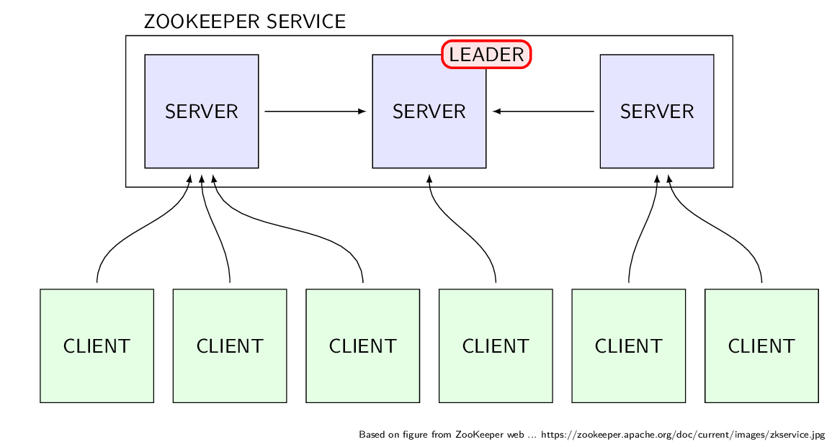
ZooKeeper Architecture Service
ZooKeeper uses a replicated client-server model built for high availability. The core components are:
Ensemble: A cluster of servers (usually an odd number, like 3 or 5).
Master: One server is elected to handle all write requests, ensuring data is updated in the correct order.
Followers: All other servers replicate the leader's data and handle all read requests.
Client: Your application connects to any server. Writes are forwarded to the leader, while reads are served locally for speed.

Slide 10
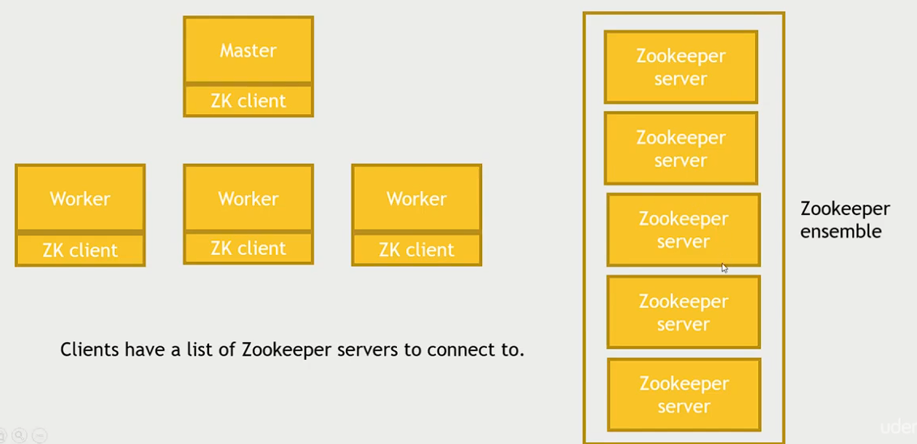
ZooKeeper Architecture Service

Slide 11
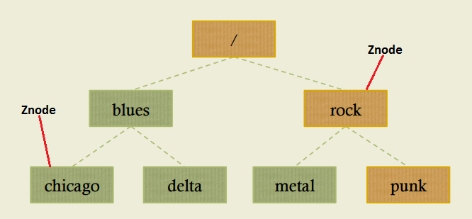
ZooKeeper's Data Model (Znodes)
ZooKeeper organizes data in a hierarchical namespace, similar to a file system.
Each node in this hierarchy is called a Znode, which can store small amounts of data.
Ephemeral Znodes exist only as long as the session that created them is active.
Big Data applications use this to monitor node health; if a node's ephemeral znode disappears, it's considered offline.

Slide 12
ZooKeeper's Reliability Guarantees
ZooKeeper provides strong guarantees, like sequential consistency and atomicity.
This means all updates are applied in order and either fully succeed or fully fail.
For a big data pipeline, this ensures that critical configuration changes are not partially applied.
These guarantees are fundamental to building fault-tolerant Big Data applications.

Slide 13
The Consensus Problem in Big Data
Consensus is the challenge of getting multiple servers in a cluster to agree on a single value.
For example, in a high-availability setup, all nodes must agree on which node is the active HMaster.
This is difficult because servers can fail or network messages can be delayed.
Without consensus, a cluster could suffer from a "split-brain" scenario, leading to data corruption.

Slide 14
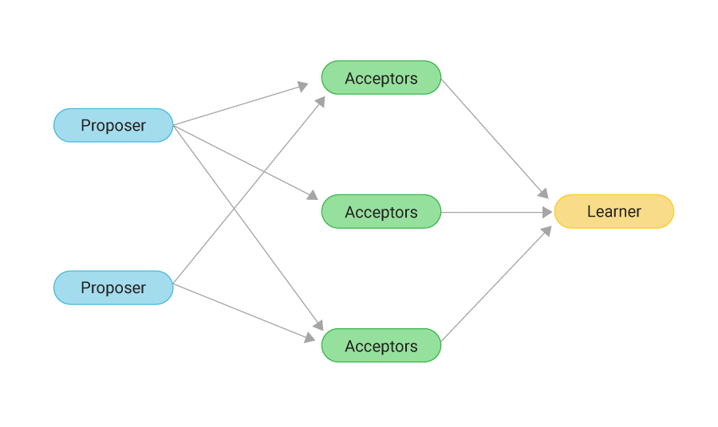
The Paxos Algorithm for Consensus
Paxos is a proven algorithm that allows a distributed system to reach consensus.
It uses a two-phase protocol (prepare/propose) to ensure only one value is chosen.
While complex, it provides the mathematical foundation for the fault-tolerance in ZooKeeper.
This fault-tolerance is what makes Big Data systems resilient to partial hardware failures.

Slide 15


Introduction to Cassandra
Cassandra is a decentralized NoSQL database built for extreme scale and high availability.
It excels at handling high-velocity data ingestion, common in IoT and web analytics.
Its masterless "ring" architecture means there is no single point of failure.
This makes it a popular choice for mission-critical Big Data applications that cannot afford downtime.
Petabyte Database, high availability, performance and vendorr independant

Slide 16
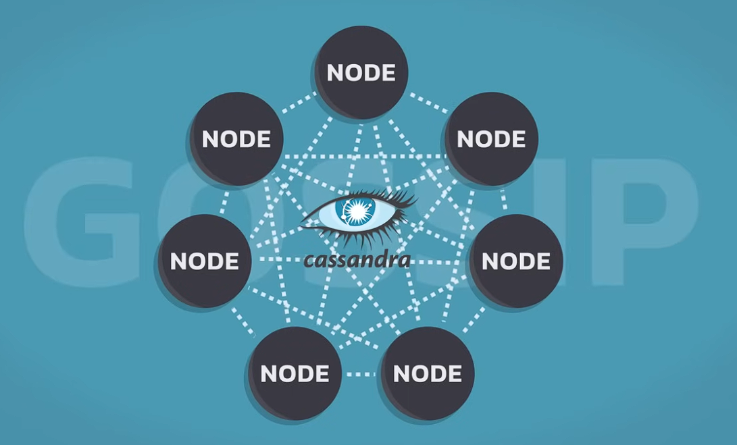
Introduction to Cassandra
Cassandra: Nodes & Gossip
Nodes:
All peers, no master.
Connected in a ring.
Data is partitioned & replicated.
Gossip:
Nodes share info randomly.
Spreads cluster state (alive, dead, metadata).
Works like word-of-mouth.

Slide 17
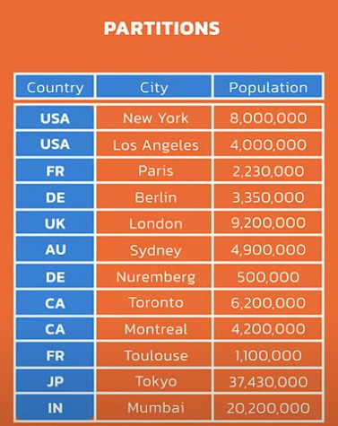
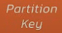
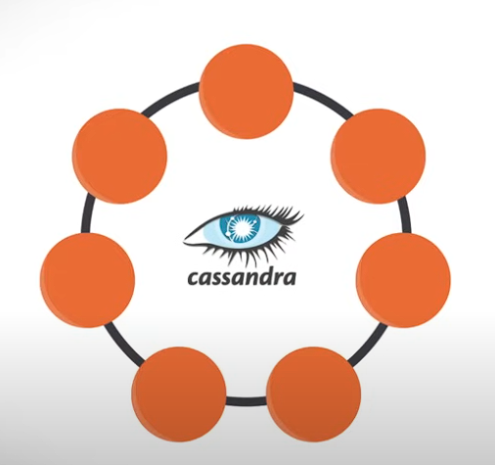
Partitions & Partition Key (Cassandra)
Partition Key:
Determines which node stores the data.
Example: If we store companies, the partition key could be country name.
"USA" → goes to Node A
"France" → goes to Node B
"India" → goes to Node C
Partition:
A group of rows that share the same partition key
Example: All companies in USA are in the USA partition.
Helps Cassandra quickly find and store data.
Why it matters:
Ensures data is evenly distributed across nodes.
Makes reads/writes fast and organized.

Slide 18
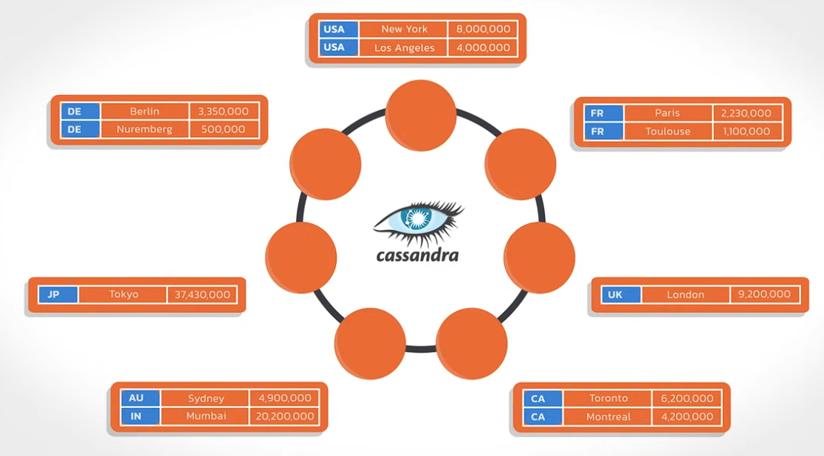
Partitions & Partition Key (Cassandra)

Slide 19
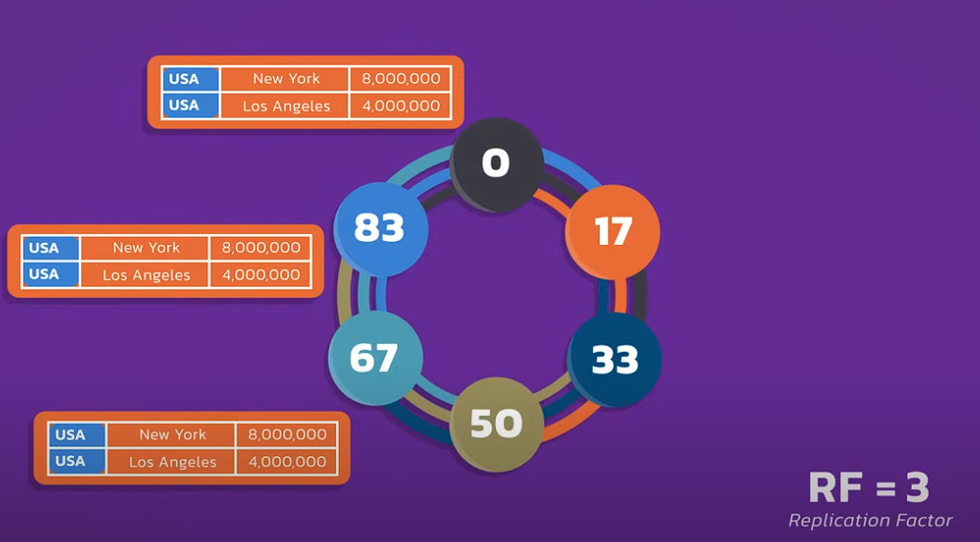
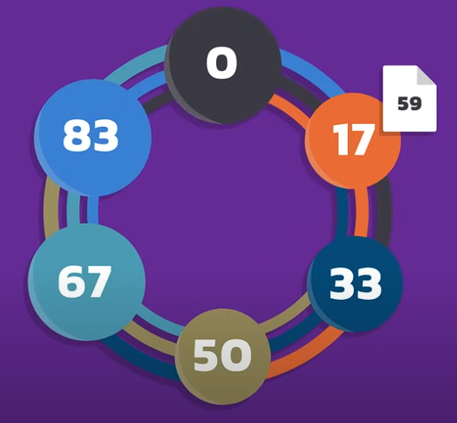
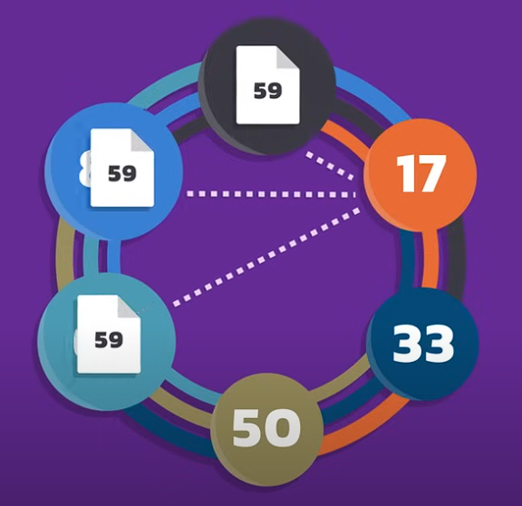
Cassandra: Replication Factor & Coordinator
Replication Factor (RF):
Number of copies of data stored across different nodes.
Example: RF = 3 → each row stored on 3 different nodes.
Ensures fault tolerance (data safe if nodes fail).
Coordinator Node:
Any node that receives a client request acts as coordinator.
Decides which replica nodes to contact for reads/writes.
Ensures consistency across replicas.
Why it matters:
RF + coordinator → reliable, consistent, fault-tolerant system.

Slide 20
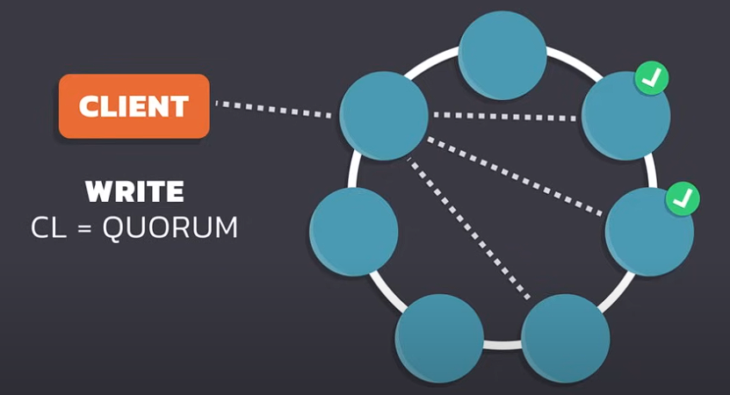
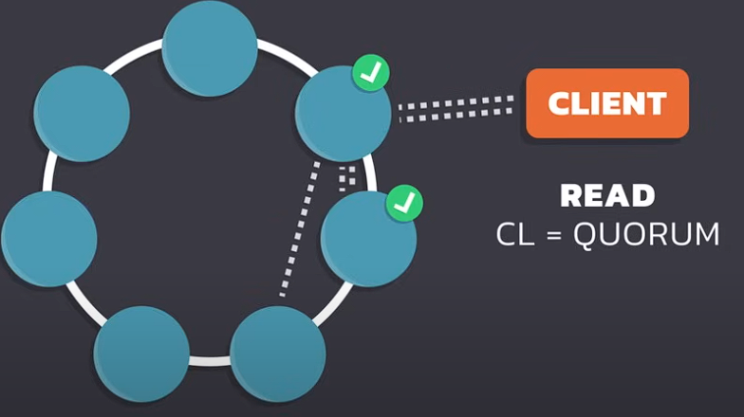
Cassandra: Quorum Reads & Writes
Write Quorum: Majority of replicas must confirm (RF = 3 → 2 nodes).
Read Quorum: Majority of replicas respond to return latest data.
Ensures strong consistency across the cluster.

Slide 21
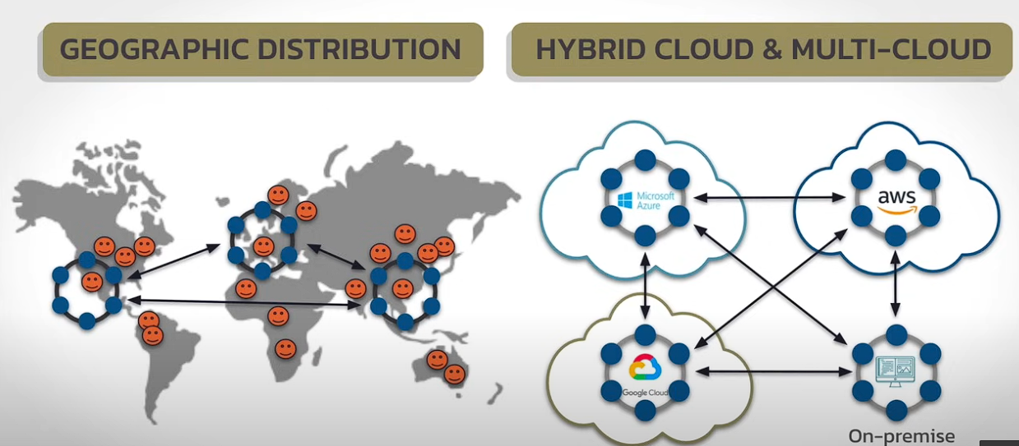
Cassandra: Quorum Reads & Writes

Slide 22
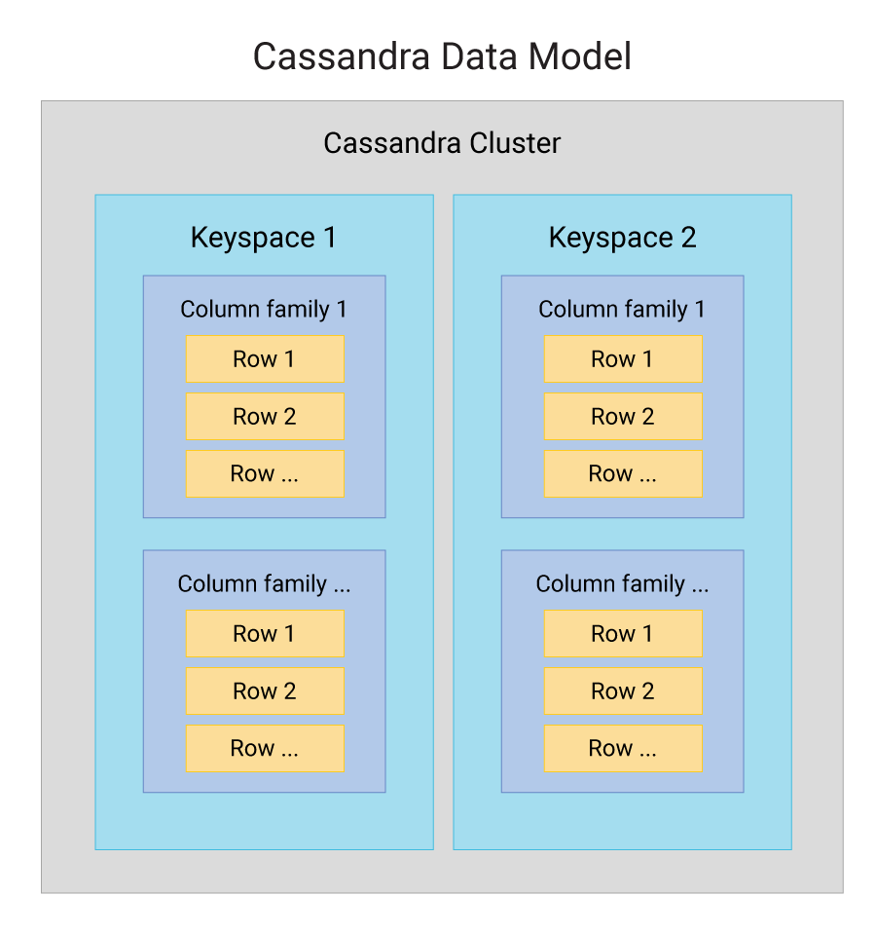
Cassandra's Wide-Column Data Model
Cassandra organizes data into Keyspaces, Tables, Rows, and Columns.
Unlike a relational database, different rows in the same table can have different sets of columns.
This schema flexibility is perfect for Big Data analytics where data structures may evolve.
It allows you to add new metrics or attributes without costly database migrations.

Slide 23
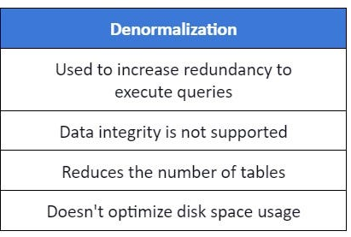
The Importance of Denormalization
Cassandra does not support joins, which are expensive operations in distributed systems.
Instead, you practice denormalization: creating tables specifically designed to answer a query.
This means you might store the same piece of data in multiple tables in different forms.
This "query-first" design approach is key to achieving high performance at Big Data scale.

Slide 24
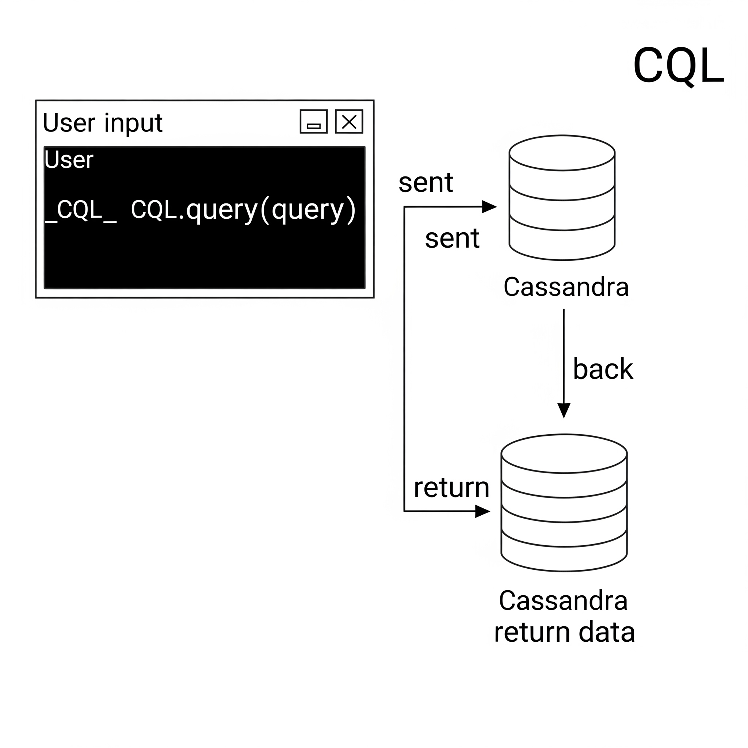
Interacting with Cassandra Query Language (CQL)
CQL is the primary way to interact with Cassandra, and its syntax is very similar to SQL.
This makes the transition easier for developers and analysts familiar with relational databases.
You can use familiar commands like SELECT, INSERT, UPDATE, and DELETE.
Example: SELECT event_name, event_time FROM user_activity WHERE user_id = 'some_user';.

Slide 25
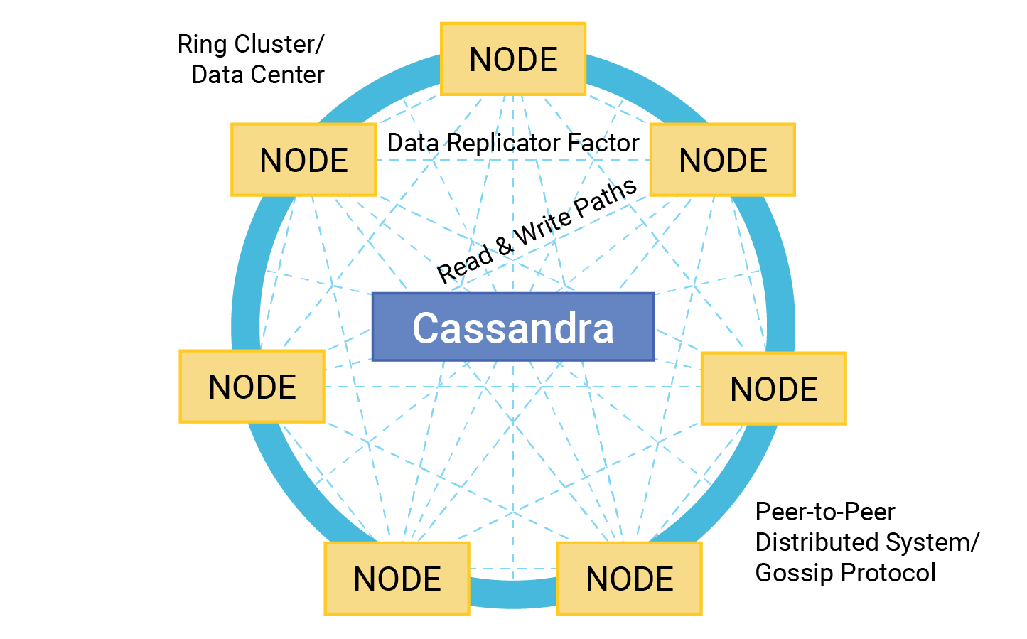
Cassandra Internals : The Peer-to-Peer "Ring" Architecture
In Cassandra, all nodes are equal; there is no master node that manages the cluster.
Nodes communicate using a gossip protocol to share information about their health and status.
This decentralized design eliminates single points of failure.
If a node goes down, the cluster continues to operate, ensuring high availability for Big Data services.
Database

Slide 26
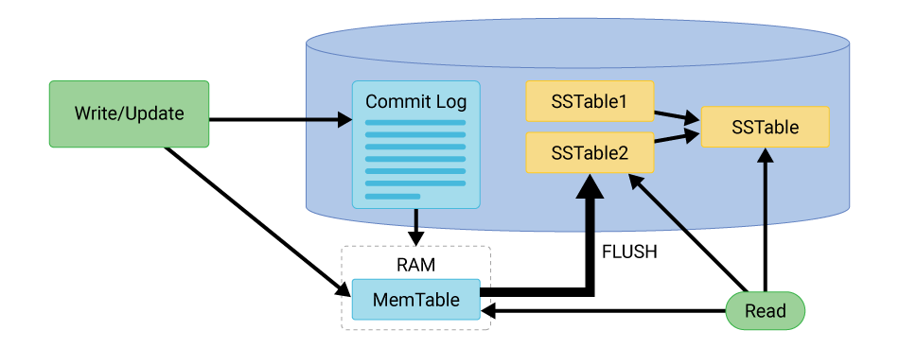
The Write Path: Memtable & Commit Log
When a write occurs, Cassandra first appends it to a Commit Log on disk for durability.
Simultaneously, it writes the data to an in-memory structure called a Memtable.
This process is extremely fast because it avoids slow, random disk I/O.
This write-optimized design is why Cassandra can handle massive ingestion rates from Big Data sources.

Slide 27
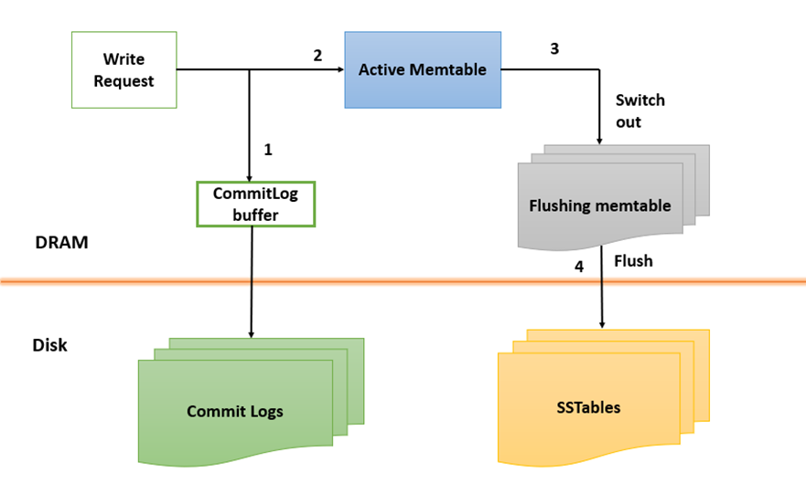
The Write Path: SSTables (Sorted String Table)
When the Memtable fills up, its sorted data is flushed to a new, immutable file on disk called an SSTable.
This is a core component of the Log-Structured Merge-Tree (LSM-Tree) data structure.
LSM-trees are optimized for systems with very high write volumes.
This makes them a perfect fit for the demands of modern Big Data applications.

